Slide 1
Cybersecurity
Buffer Overflows

Slide 2
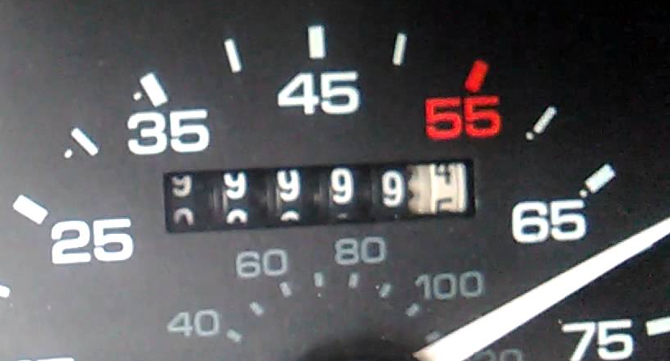
Buffer Overflow
When data exceeds the space allocated for it
What happens when odometer in a car shows all 9’s and then goes just 1 more?
It rolls over to all 0’s. Where does the next digit go?

Slide 3
Buffer Overflow
Data being stored in computer memory can exceed the amount of room provided for it. Where does extra data go?
The amount of memory dedicated to a task is known as a Buffer.
In certain systems, overflow data “spills” into other areas of memory and can overwrite critical memory used by OS or some service.
Can be fatal (DoS)
Or provide read access to data in memory that would otherwise be off limits

Slide 4
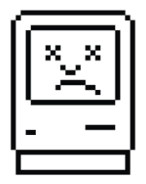
Buffer Overflows
Developers need to perform bounds checking
Hackers examine software for weaknesses
Not an exploit that is easily discovered
Takes a lot of practice to avoid crashing critical components
Trial and error
Must find right values to create other vulnerabilities
Most useful buffer overflow is repeatable across many systems

Slide 5
Variable Name | A |  |  |  |  |  |  |  | B
Value | E | X | C | E | S | S | I | V | 25856
Hex Value | 65 | 78 | 63 | 65 | 73 | 73 | 69 | 76 | 65 | 00

